Slide 1
Local democracy in Europe and in Ukraine
Marc Cools
Kharkiv 16 May 2017

Slide 2
The Council of Europe
The rule of Law
Human rights
Democracy

Slide 3
The Council of Europe in Strasbourg

Slide 4
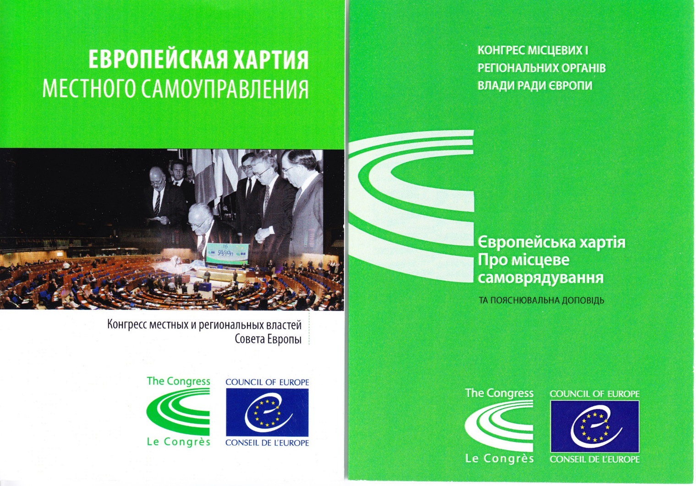
The European Charter of Local Self-Government

Slide 5
The last monitoring before Maïdan

Slide 6
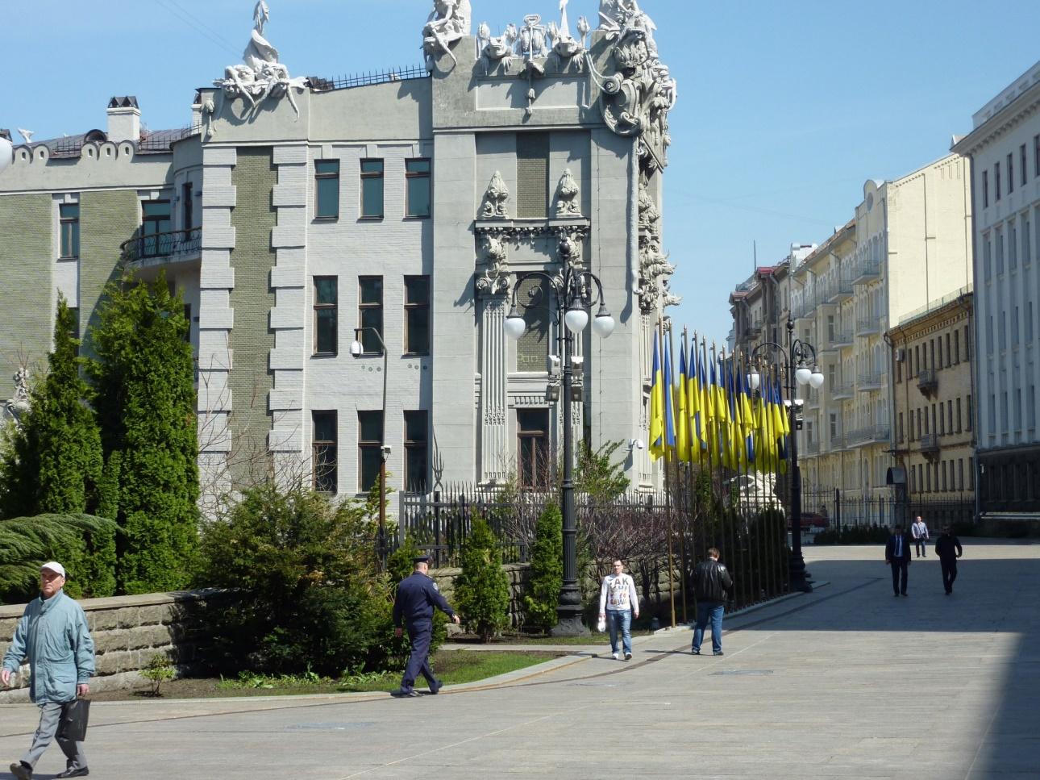
A post-monitoring in 2014 & 2015
The roadmap of the post-monitoring was signed by the Ukrainian Government on 20 May 2015.

Slide 7
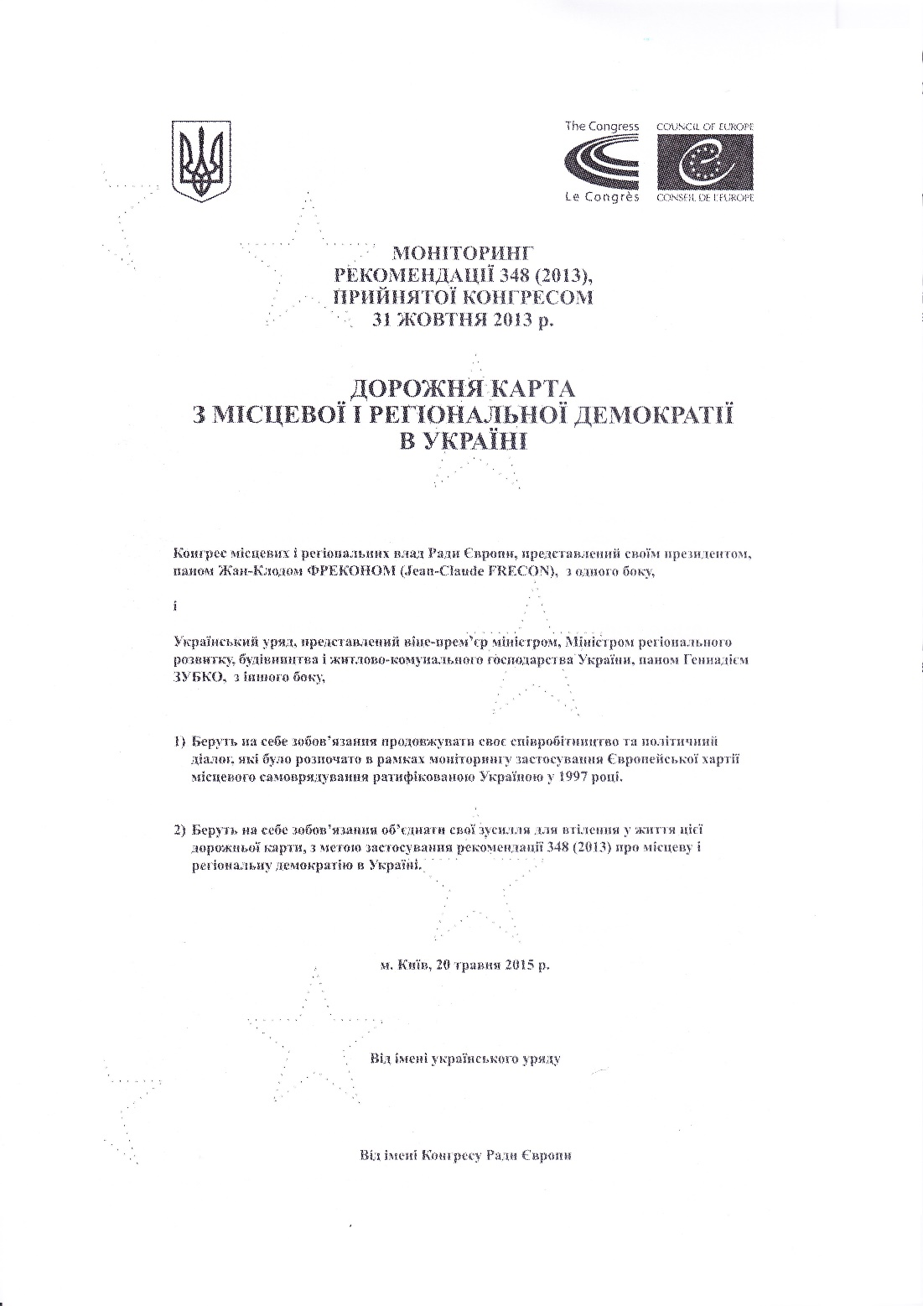

Slide 8
Two major debates throughout Europe
Without financial means, autonomy is only autonomy to do nothing.
Very small local entities do not have a sufficient critical size to exercise broad powers.

Slide 9
The principle of subsidiarity
The application of the principle of subsidiarity strengthens the effectiveness of public action.
Democracy is not the verticality of power.

Slide 10
More decentralisation is better for regional economic development

